Slide 1

CS201 Final Project
Aditya Aggarwal (2020CSB1066)
Anubhav Kataria(2020CSB1073)
Prakhar Saxena(2020CSB1111)
Instructor: Dr Anil Shukla
Mentor/Teaching Assistant: Ravi Bhatt

Slide 2
Goals
Create a region Quad Tree to store information in form of 2D Points associated with a data value.
Use recursive paradigm to search and insert a node in Quad Tree
Using Quad Trees compress grayscale images by assuming that adjacent pixels in an image have approximately same intensities and combine them into one with intensity as their average value if the combined variance of a section of pixels is less than a threshold.

Slide 3
Development Log
Spent initial few days trying to understand what are Quad Trees and different types of quad trees. Discovered two major types- Point Quad Tree & Region Quad Tree. Finally proceeded with Region Quad Tree as they are used in image processing applications.
Wrote 2D Point Quad tree all functions
Wrote image processing Quad Tree functions with ideas from previous implementation but with certain important modifications.
Wrote a professional presentable main driver code for both the programmes.
Wrote a Makefile and finalized the project

Slide 4
Collaboration Techniques
Used VS Code code with Live Share feature where in multiple users could code on a single system, working together at same time on different parts of project
Regularly pushed the updates to github repository after collab sessions and discussion among all members.
For report writing used overleaf where all of us worked on the document using link sharing feature.

Slide 5
Important Points to understand Code
Bottom
Top-Y
2D Point Quad Tree
Image Quad Tree
Left-X
Left
Right
Right-X
N
W
E
Top
Bottom-Y
S

Slide 6
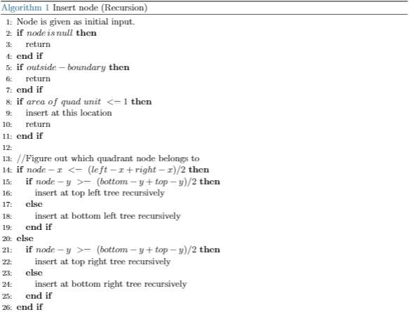
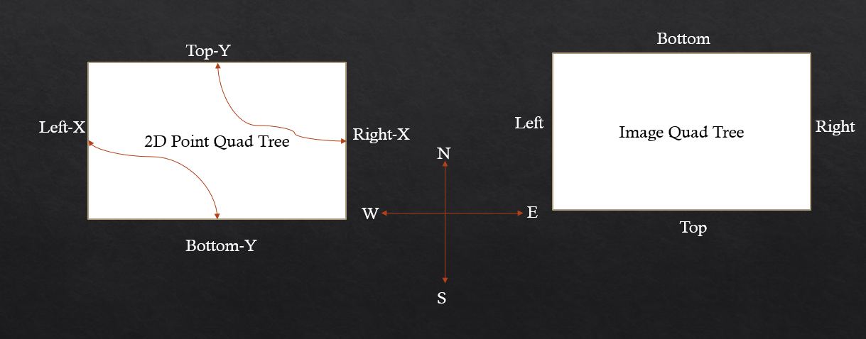
Important Code Fragments-2D Point Quad Tree

Slide 7
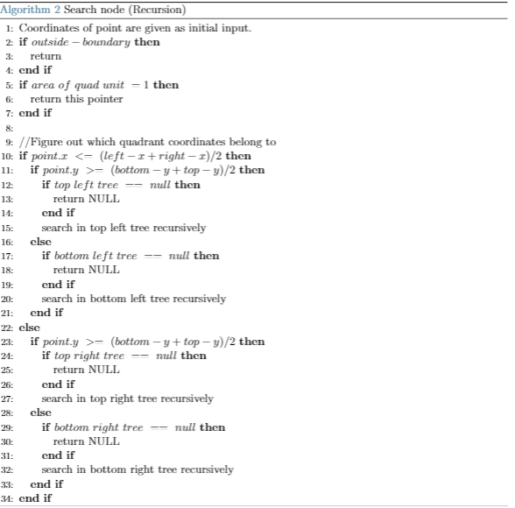
Important Code Fragments-2D Point Quad Tree

Slide 8
Code Deployment Time Real-Time or Pre-Recorded Video?

Slide 9
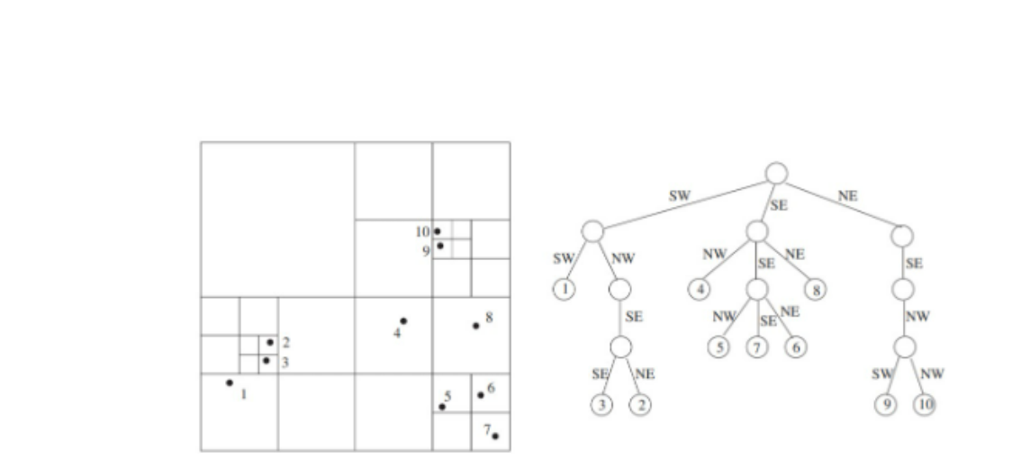
Bottom Top Left Right
Reference to four child pointer, the pixel array reference, value, is_leaf

Slide 10
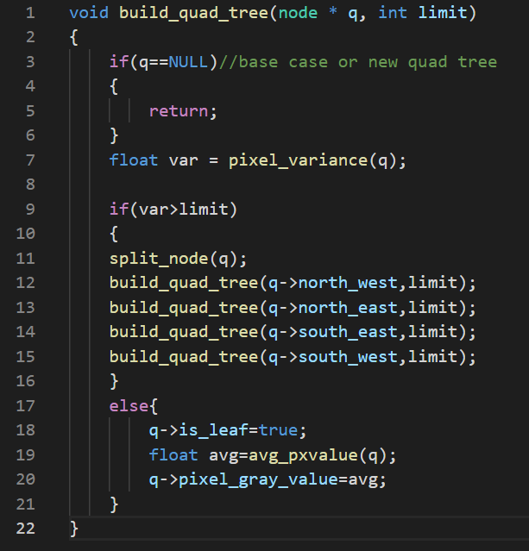
Important Code Fragments-Image Processing

Slide 11
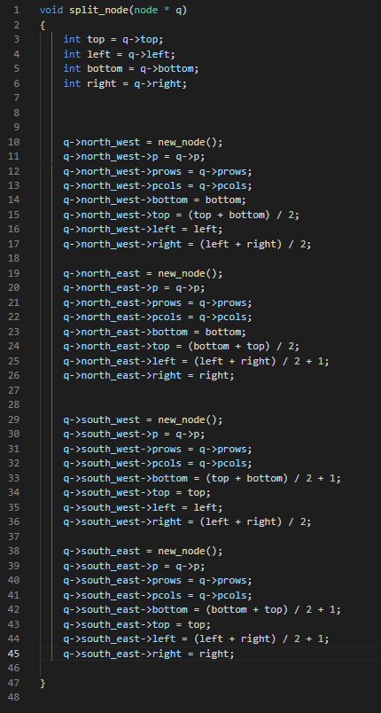
Important Code Fragments-Image Processing

Slide 12
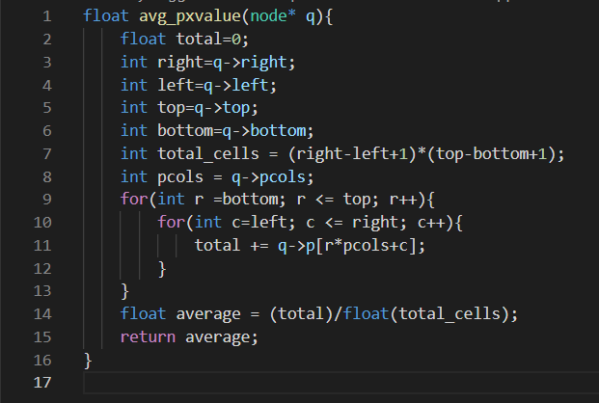
Important Code Fragments-Image Processing

Slide 13
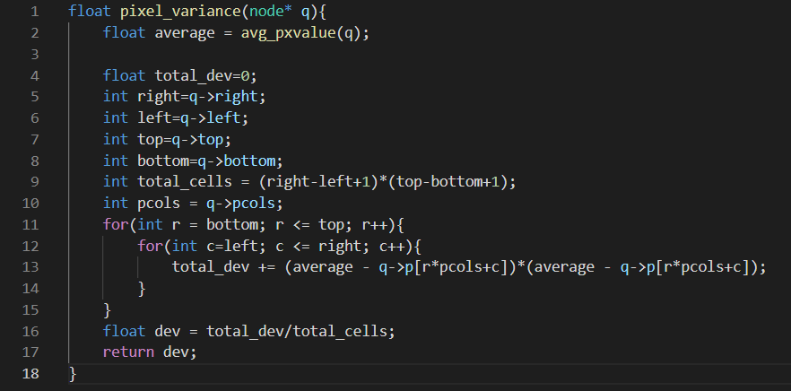
Important Code Fragments-Image Processing

Slide 14
Code Deployment Time Real-Time or Pre-Recorded Video?

Slide 15
Few Practical Implementation of Quadtrees
Quadtrees have a wide scope to be used in tech industry. It is widely used in various processes to get desirable results. Some of the implementation of Quadtrees are as listed below:-
1. Spatial Indexing
2. Image Compression
3. Gaming Graphics
4. Geolocation and Scaling Internet Services

Slide 16
Image Compression
Images in large quantity take a lot of space. We often see our device memory running out and space taken by images is a huge factor in doing so. But most forms of image compression help solve these problems by reducing the size of the image and thus reducing the overall pixels and memory they take up.
Quadtrees for image compression works by recursively dividing the image into four subspaces with each holding the average RGB color and the error determining that color for its subspaces.
As for the extend of compression it depends on the user how much percent error he is willing to compensate in order to compress the image.

Slide 17
Spatial Indexing
Spatial indices are used by spatial databases (databases which store information related to objects in space) to optimize spatial queries. Now Quadtrees divide the space into 2-D Plane and optimize it's searching efficiency. We lessen the number of queries by a factor of 4 with each iteration.
Spatial Indexing itself is used in many areas including geolocation where we find the coordinates of a location using Quadtrees. We compare the centre coordinates with the desired coordinates and choose the quadrant(child) based on it. We recursively do this process till we find the coordinates.

Slide 18
Thank You

